Slide 1
A20 ARCHITECTURE OPTIONS Point of View

Slide 2
A2O Architecture Options – Introduction
SITUATION
BACKGROUND
A20 Technology Architecture evaluation conducted in Q4'2019 presented an opportunity to review the current architecture and identify improvement opportunities to address potential issues that may be contributing to tenant adoption challenges in the areas of data access, data quality, system performance, and system availability.
The key recommendation was to enable tenant flexibility in selecting technologies which are suitable to the specific uses in analytics consumption layer (Databricks/Snowflake/SQL DW, Cosmos, Graph, etc.).
Over the past 4 years Azure cloud platform has matured, offering mature technology options while tenant use case needs have evolved.
Synapse and Snowflake are the leading Cloud DW solutions that most companies are using. While Snowflake brings in strong DW capabilities; Microsoft Synapse brings in the end-to-end integrated capabilities such as, security, data pipeline and data management.
Both platforms have compelling features and capabilities. However, Snowflake is mostly confined to the Data Warehouse capabilities and features.
Azure Synapse analytics provides unified platform experience enabling end-to-end data security, pipeline and data management capabilities for both structured and unstructured data in a single pane of glass.
All services work within the same single tenant to offer a significant security advantage (less network hops, lower data breaches).
Enables significant reduction in development time by providing integrated development environment along with CI/CD capabilities.
Cost savings realized by lower price performance $ per Query per Hour backed by GigaOm TPC test results.
Use the end-to-end integration capabilities of Azure Synapse Analytics to improve customer experience at a lower price point.
Start with using Synapse (SQL DW) immediately in the tenant zone and explore its fit in the remaining zones.
Use Azure Data Factory for Ingestion, DataFlow (ETL), and Orchestration
ASSESSMENT
RECOMMENDATION

Slide 3
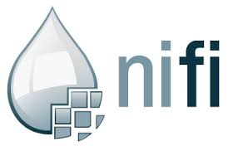












Kaiser A20 Reference Architecture – Current State
Security
Security
Data Acquisition & Staging
Data Stores
Analytics
Information Access & Delivery
Ingest
Refined
Zone
User
Zone
Data Analytics as a Service
Diagnostic/
Descriptive
Predictive & Prescriptive
Visualization
Portals
In motion
LEGEND
Stream
Reporting
Data Discovery
Power BI
Power BI
Self-service
Messaging
Enriched
Zone
Tenant
Zone
Operational Analytics
Dashboards
Business Intelligence
SQL Server Analysis Services
Advanced Analytics
Raw Zone
Statistical Modelling
Alerts
Real-Time Analytics
Azure ML Server-R
Microsoft Application Native to MS Azure
At rest
Natural Language Processing
Azure Machine Learning
Replicate
LLAP
Archival Zone
Online Analytical Processing
Analytic as a service APIs
RDBMS connect
Express Routes
Azure SQL DB
TEZ
Cognitive
Text
Vision
Spark
Business Rules
Cortana
Azure Data Lake Storage
Ad-Hoc Analysis
Machine Learning
Recommend
Emotion
Third Party Application Native to MS Azure
File-Based
HD Insight Hadoop
Azure ML Studio
Adapters
Bot
Speech
Adapters
Azure Data Lake Storage
HDInsight Hbase
Azure Blob
Additional technologies to enable Analytics
Data Management
Data Management
Metadata
Tagging
Lineage
Data Governance
Data Quality
Master Data Management
Collibra
Waterline Data
Atlas
Collibra
Waterline Data
Tamr
Key Vault
Key Mgmt.
SafeNet
Kerberos
Ranger
Azure Encryption
Authentication
Authorization
Encryption

Slide 4
A20 ARCHITECTURE OPTIONS
TECHNOLOGY OPTIONS
 | CURRENT STATE | MICROSOFT AZURE ROADMAP ALIGNED | ALTERNATIVE TECHNOLOGIES ON AZURE
DATA ACQUISITION, STAGING & PROCESSING | Data Engineering Toolkit on Azure HDInsight | Azure Synapse Analytics | Azure Data Factory/ Informatica IPaaS/BDM
KP ADF PLATFORM - RAW | ADLS | ADLS | ADLS
KP ADF PLATFORM – REFINE, ENRICH, and TENANT | Azure HDInsight | Azure Synapse Analytics | Snowflake
ADVANCED ANALYTICS (AI/ML) | Azure ML | Azure Databricks + Azure ML | Azure Databricks + Azure ML
BUSINESS INTELLIGENCE | PowerBI, SSAS, Tableau, Cognos | PowerBI, SSAS, Tableau, Cognos | PowerBI, SSAS, Tableau, Cognos
DATA MANAGEMENT (Metadata, tagging, quality, governance etc.) | KP Standard – Collibra, Waterline data | Azure Catalog and Governance (Babylon) | Informatica Data Management

Slide 5




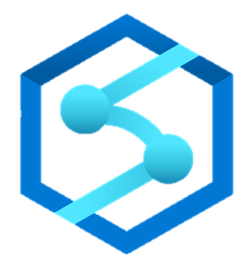

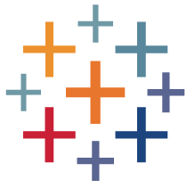

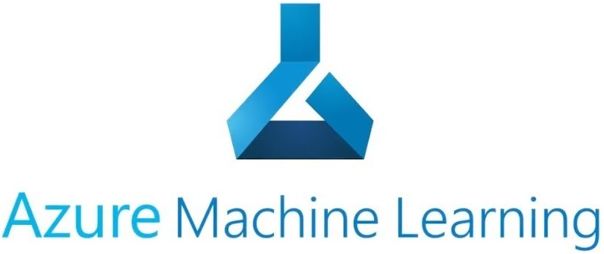
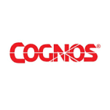

Kaiser A20 Reference Architecture – Future State Options
Security
Security
Data Acquisition & Staging
Data Stores
Analytics
Information Access & Delivery
LEGEND
Ingest
Refined Zone
User Zone
Informatica BDM
Data Analytics as a Service
SNOWFLAKE
Best of Breed on Azure
In motion
Stream
POWER BI
Event Hub
Messaging
AZURE SYNAPSE ANALYTICS
Enriched
Zone
Tenant
Zone
Business Intelligence
Advanced Analytics
Raw Zone
TABLEAU
Microsoft Roadmap Aligned
At rest
Replicate
Archival Zone
Analytic as a service APIs
RDBMS connect
Azure Data Factory
Business Rules
Azure Databricks
Clearlake
SSAS
Microsoft Application Native to MS Azure
File-Based
Kafka
Azure Data Lake Storage
Adapters
Adapters
Express Routes
Third Party Application Native to MS Azure
Data Management
Data Management
AZURE CATALOG & GOVERNANCE(BABYLON)
INFORMATICA DATA MANAGEMENT
Additional technologies to enable Analytics
Metadata
Tagging
Lineage
Data Governance
Data Quality
Master Data Management
Collibra
Waterline Data
Atlas
Collibra
Waterline Data
Tamr
Key Vault
Key Mgmt.
SafeNet
Kerberos
Ranger
Azure Encryption
Authentication
Authorization
Encryption

Slide 6
Compare & Contrast – Synapse vs. Snowflake
SUBJECT AREA | KEY SYNAPSE DIFFERENTIATORS | SNOWFLAKE’S SOLUTION ALTERNATIVE
UNIFIED PLATFORM | Unified platform experience enables data Ingest, Explore, Prep, and Serve in a single pane of glass. It includes Azure Data Discovery & Governance (Babylon) tool which allows Inventory, Governance, Discovery & Curation of data; this also allows for an integrated assessment, compliance, regulations, policies & protection of data simplifying analytics | Multi-tool experience (e.g., ADF for ingestion, Snowflake for explore, prep, PowerBI for Serve, Ranger for authorizations etc..)
END-TO-END DATA LINEAGE | Provides data consumers & producers information with 360-degree view of the data w.r.t what, where, who, when and why the data was used simplifying data management
SECURITY | All services work within the single tenant eliminating multiple hops (less network hops, lower data breaches) | Snowflake provides virtual private IP option does not eliminate network hops
DATA INGESTION & MOVEMENT | Simple ingestion with integrated Kafka/Event Hub/ADF enhances productivity, additionally supports code free data flows (DAG), code-free data transformation, analytics at scale and data wrangling (preview) with minimal manual effort | Expensive ingestion using Snowpipe lacks DAG (Directed Acrylic Graphs) capabilities
UNSTRUCTURED DATA | Supports structured and unstructured data formats to meet the modern use cases | Supports only Structured and Semi Structured data formats
CONCURRENCY | High Concurrency (via scale out), Lower latency SLA (<3 sec) increases performance with fewer resources | Claims of unlimited Concurrency may fall short due to the limit of 8 concurrent queries per cluster; customers are left to create more virtual warehouses to compensate for concurrency limitations
ORCHESTRATION | Data pipeline Orchestration at Scale, allows Azure ML as a step in the Data pipeline enabling AI / ML advanced analytics use cases | Tasks and streams does not allow for AI/ML use cases
STORED PROCEDURES | Supports T-SQL Stored Procedures leveraging existing skills | Supports Java Script Stored Procedures
INTEGRATED DEVELOPMENT ENVIRONMENT | Enables significant reduction in development time by providing integrated development environment (Visual Studio .NET) along with CI/CD capabilities. | No out of the box DevOps CI/CD capabilities available
NOTEBOOKS | Supports Notebooks which enable multi language development environment with single interface | Supports notebooks if used alongside with Databricks
DATA ENGINEERING TOOLKIT | Supports replacement of Data Engineering tool Kit with Synapse enabling end-to-end data pipeline capabilities

Slide 7
Compare & Contrast – Snowflake vs. Synapse
SUBJECT AREA | KEY SNOWFLAKE DIFFERENTIATORS | SYNAPSE’S SOLUTION ALTERNATIVE
OFFERING TYPE | Snowflake is a SaaS offering eliminates the need for managing IaaS and PaaS capabilities | Synapse is a PaaS offering on Azure platform
BILLING | Allows for more granular per second billing | Per hour billing, however reserved capacity discounts are available; serverless, Pay-as-you-go pricing model is available
VIRTUAL DATA WAREHOUSE | There is no cost to create unlimited virtual warehouses and DDL's
DYNAMIC SCALING | Initial size of a compute cluster can be resized at any time, even when the query is running. | Configuration based auto scaling provides up/down resizing
DATA SHARING | Share data within your account or with other Snowflake accounts (sharing data with other accounts works only if the participant also has a snowflake account), sharing allows access to data without having to copy or transfer data from the data provider’s account to the data consumer’s account; Snowflake data sharing also works across clouds. | Faster Data Sharing only works on Azure with other participants having Azure accounts.

Slide 8
A20 ARCHITECTURE OPTIONS
EVALUATION CRITERIA AND FINDINGS
EVALUATION CRITERIA | MICROSOFT ROADMAP ALIGNED |  | BEST OF BREED ON AZURE
USE CASE COVERAGE (Analytical, Governance, AI/ML) | Babylon integrated with Synapse provides data management- tagging, lineage, governance, quality and metadata Synapse Analytics - provides a unified ingest, orchestration & dataflow Supports both structured and unstructured datasets |  | Additional process/tools required for data management, ingest, and unstructured datasets
COST EFFICIENCIES (Price - performance) | Lower price performance $ per Query per Hour based on GigaOm TPC results |  | Storage Cost can be slightly higher against standard Object store cost
EASE OF ADOPTION (Skillset, Development time, Migration) | Integrated Development environment (Visual Studio) Continuous Integration & deployment using Azure DevOps |  | Web Based UI and Command Line Client (CLI)
OPERATIONAL SUSTAINABILITY (Maintainability, Scalability, Reliability ) | Single pane of glass for all services Integration with Azure Monitor and Log Analytics |  | Multiple Access paths to Individual Service Management Online Scaling Snowflake
SECURITY | Native Row Level Security Advanced Threat Protection All capabilities within the same tenant significantly reducing network hops |  | Secure View Based Security control No Native Azure Active Directory Integration

Slide 9


Recommendation
Assessment
Both platforms have compelling features and capabilities. However, Snowflake is mostly confined to the Data Warehouse capabilities and features.
Azure Synapse analytics provides unified platform experience enabling data Ingest, Explore, Prep, and Serving of data for both structured and unstructured data in a single pane of glass.
Azure Synapse integrates Azure Data Discovery & Governance (Babylon) tool capabilities which allows Inventory, Lineage, Governance, Discovery & Curation of data along with integrated assessment, compliance, regulations, policies & protection capabilities greatly simplifying end-to-end analytics
All services work within the same single tenant to offer a significant security advantage (less network hops, lower data breaches).
Enables significant reduction in development time by providing integrated development environment along with CI/CD capabilities.
Cost savings realized by lower price performance $ per Query per Hour based on GigaOm TPC results
Recommendation
Use the end-to-end integration capabilities of Azure Synapse Analytics to improve customer experience at a lower price point.
Start with using Synapse (SQL DW) immediately in the tenant zone and explore its fit in the remaining zones.
Use Azure Data Factory for Ingestion, DataFlow (ETL), and Orchestration

Slide 10
Appendix

Slide 11
A20 ARCHITECTURE OPTIONS – Responses to KP Queries
The set of core (internally consistent) design principles we are adhering to e.g., MS Azure ecosystem and tools first, 3 data zones, ELT / late binding vs ETL early binding, as simple as possible -- no duplicate foundation services / data / data management tools, modular design – abstraction and APIs, etc.
Response: Agreed, the key design principles for this position are
MS Azure ecosystem and tools first
Use Standardized industry data Zones best practices
No duplicate foundation services / data / data management tools
Use Modular design
Independent scaling of Compute and Storage Resources
Scale to Support demand and meet performance standards
Efficiently monitor and manage the platform
Design for shared-data architecture
Efficiently monitor and manage the platform
Evaluation criteria we used to make design choices and decisions;
Effectiveness / Reliability (30%): gets the job done every time – required capabilities and features based on both current and future needs
Efficiency (30%): cost effectiveness both to implement/deploy and operate and maintain
Scalability / Consistency (20): can we scale with more tenants, use cases, data, etc. does it help drive consistency and alignment
Maintainability / Sustainability (20%): this is both an operating model question along with whether it is “future proof”
Response: Below is the evaluation Criteria used which covers above listed choices
USE CASE COVERAGE (Analytical, Governance, AI/ML)
COST EFFICIENCIES (Price - performance)
EASE OF ADOPTION (Skillset, Development time, Migration)
OPERATIONAL SUSTAINABILITY (Maintainability, Scalability, Reliability )
SECURITY

Slide 12
A20 ARCHITECTURE OPTIONS – Responses to KP Queries (cont’d)
I agree that there are 2 main use cases, but I just wanted to point out “variations”
Analytic Use Cases | Internal only | External 3rd party processing e.g., NCAP strata | External 3rd party submission e.g., regulatory
Operational and financial performance management – reporting, dashboard, etc. - generally retrospective, descriptive, diagnostic including segmentation information – on an aggregated or functional/regional or unit / group levels | Highly dimensional structured large datasets that needed to be refresh regularly and continuously and can support standard BI capabilities, tools and reporting Could be real-time and/or self-serve depending on needs
Operational and financial performance improvement or discovery – analytics, including segmentation, forecasting, etc.- generally prospective, predictive, prescriptive, cognitive information – – on an aggregated or functional/regional or unit / group levels | Possible blend of both structured and unstructured data that needed either on one-time basis or ongoing if it is an analytic model or algorithm that is going to be put in production. Need AI/ML/DL, R/python along with model manager and libraries Could be real-time and/or self-serve depending on needs
ADF needs to support two high-level business use cases: Highly structured data warehousing to support retrospective reporting, dashboards and self-service and more emerging machine learning, artificial intelligence and near time analytics that provide predictive and prescriptive insights. This is important because we need to make sure that we have data in formats and technology to support both. This aligns with the vision Uli described where different analytic services draw from the same data lake.
Response: Both of these use cases are considered in the evaluation of the position paper
Architectural decisions for ADF were made based on Systems of Intelligence (SOI) strategy work done several years ago. During the Microsoft meeting there was an impression that the current architecture may have missed the mark, but it is good to recognize that this space is rapidly evolving and many of the decisions made are still well aligned with KP needs. Examples include logical architecture (raw, refined, enriched, tenant), need for a data lake in Hadoop to bring together data, use of Cloud and separation of storage and compute. That said, because the analytics and big data space is rapidly evolving, we should expect to regularly look at architecture and do our best to future proof design. There is likely an opportunity to message this to our sponsors.
Response: – This was considered as part last year's A20 technical architecture review and the background

Slide 13
A20 ARCHITECTURE OPTIONS – Responses to KP Queries (cont’d)
The program has made significant progress using the current architecture and we need to be very thoughtful about impacts to the program’s budget, timeline, staff skills and re-work of making architectural changes. Hopefully this is more evolution than revolution. The transition to using cloud and open source technologies is a significant change management challenge and introducing more change without clear benefits will be difficult to communicate to our sponsors and team. There are some key requirements – change data capture, access and use, performance tuning, how to organize and store the data, automated balance control, tagging, metadata and ETL/ELT – that we have spent a significant amount of time on and we need to be careful about implications of changing.
Response: These capabilities are integrated and offered out of the box in Synapse, existing work around Shared services (automation, metadata etc.) can be leveraged if there are not a lot of code changes involved, most of the other work items will need to be developed using new technologies, Common reusable frameworks/accelerators are recommended to expedite work.
Looking more specifically at the architecture, there are some crux questions we need to answer:
Is Hive the right technology to lay down KP data in the data lake to support our analytic use-cases? And, in what layers (refined, enriched, tenant) should Hive be used? And what format (ORC or parquet) should it be stored in? Does this align with Microsoft vision and roadmap for Clear Lake, Babylon and Synapse? I got mixed signals from Microsoft and think it will be important to have Microsoft confirm this. A change away from Hive will be a significant departure that will require re-work and will impact the budget and timeline of the program.
Response: Hive is not true RDBS and not designed to support high volume of querying, that is the reason why we are recommending Synapse for both Structured and Unstructured data use cases

Slide 14
A20 ARCHITECTURE OPTIONS – Responses to KP Queries (cont’d)
b. Do we need to introduce a data warehousing layer to the ADF architecture? If so, does it fit just in the tenant zone, or in refined and enriched as well? Our current architecture is ambiguous. In 2019 RMA attempted to use Hive plus LLAP and it was very challenging. RADA was able to make it work. Using Hive in all zones has benefits (integrated security, less copies of data, easier to support one technology, etc.) but there are concerns about the cost to develop and maintain data in Hive, if it will support automated performance tuning, cloud optimization, etc like Snowflake and if it will continue to be supported and advanced.
Response: Tenant zone will leverage database and have data warehouse like data structures to provide coverage for variety of analytical user queries, rest of the zones will be accessible via SQL like interface but do not need to have data warehouse like data structures.
If we should introduce a data warehouse layer, how do we evaluate between Snowflake and SQL Server DW? Snowflake is ready now, was designed for cloud-based data warehousing, has a very strong and happy user base. That said, to achieve many of the benefits requires another copy of the data into a proprietary format. The Microsoft vision for Synapse seemed compelling, especially the ability for the data warehouse to draw data into cache instead of making a copy of the data. That said, it is not yet available. How tight of integration will there be between SQL Server DW and Synapse? If we use SQL Server DW now will it make transition to Synapse easier? As we’ve mentioned before, for structured data warehousing we want a single solution pattern to reduce cost and ensure integration and consistency.
Response: SQL DWH and Synapse Analytics are mostly the same from data warehouse standpoint; however additional components of Synapse studio will address multiple data management and security needs.
Since the beginning of the program there have been concerns about having KP develop an ETL tool. We’ve asked on several occasions to review this. At the 1/24 meeting Microsoft also asked about this decision. What is the future of DET? One of the Tech Review recommendations was to look at Informatica BDM. Would this replace DET? Would we use DET for some aspects of the solution? And, given tight integration with Microsoft, should we consider Azure Data Factory?
Response: Azure Synapse Data factory is recommended

Slide 15
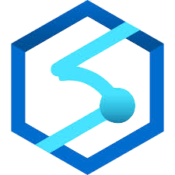
Microsoft Azure Synapse - Key Benefits
Scaling & Performance
Limitless scale; Powerful Insights; Unified platform & experience - integration, management, metastore, monitoring, SQL, Apache Spark ADLS and ADLS Gen2
High Concurrency (via scale out), Lower latency SLA (<3 sec)
Security & Compliance
Row level, column level & dynamic data masking
AAD trust architecture for security and access control
Detect and investigate anomalous database activity and actionable alerts
30+ industry leading compliances
Monitoring & Management
Best in class monitoring and management
DW Capabilities
Azure Synapse Analytics- Ingest, Explore, Prep and Serve all in a single pane of glass
Many modern languages support: SQL, Python, .NET, Java, Scala and R
Resultset caching, Materialized Views, Ordered Columnstore, and JSON support
Notebooks support and Code free data flows
Simpler architecture for A20 Digital Data Platform - removal of HDI HBase, HDI Hive, HDI Hive LLAP and SQL Server Analysis Services
Gradual replacement of Data Engineering Kit with ADF
ADF
Simple ingestion with ADF COPY
Polybase parallel structured streaming to directly load into Azure Blob Storage and SQL DW
Data Acquisition – ADF and cloud-based data integration platform
Data ingestion from various sources: SFTP, SAP, Amazon S3, Google BigQuery, SQL Server, Oracle, Teradata, File, APIs, etc.
ADF
ADF for data integration - serverless, scalable and Hybrid. Data movement at scale (up to 2GB/s in the cloud).
Data pipeline Orchestration at Scale; AML as a step in Data pipeline
Code-free data transformation, analytics at scale; and wrangling dataflow (preview)
Native Prediction/Scoring (preview)
ADF templates for head start
Data Preparation - Azure Databricks provides superior data preparation capabilities and enables advanced analytics
Connectors
90+ Built in Connectors & Growing
Databricks SQL DW connector for batch and structured streaming
Costing
Cost effective: serverless, Pay-as-you-go
Data Management
Azure Data Discovery & Governance (Babylon) - A single pane of glass to Inventory data; Discover & curate; Assess compliance & protection; Set & manage data policy
Data Lineage
Data Consumers & producers - what data do I have; what is in the data; where data originated; can I change it; can I trust data; who else has used data? Who is using data and for what purpose? is data compliant with regulations and policies?
AI/ML
Azure Databricks and Delta lake provide the latest analytics and Insights
Delta Lake provides ACID, Rollbacks and time travel capabilities
Support for AI, ML, IoT, Intelligent Apps / Business Intelligence

Slide 16
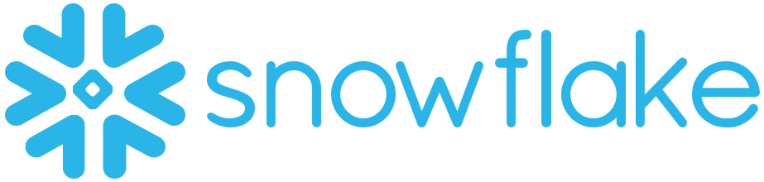
A20 ARCHITECTURE OPTIONS - Snowflake
Snowflake is a SaaS offering.
Multi-cluster, shared data architecture to process enormous quantities of data with maximum speed and efficiency.
Micro-Partitioning
Automatic Micro-Partitioning.
Groups of rows mapped into individual micro-partitions, organized in a columnar fashion.
Extremely granular pruning of very large tables.
All metadata about all rows stored in a micro-partition.
Automatically most efficient compression algorithm.
Virtual Warehouse
A cluster of compute resources; provides resources, such as CPU, memory, and temporary storage, to perform DML operations.
No limit to number of warehouses within an account.
Initial size of a compute cluster can be resized at any time.
Multi-cluster warehouses deliver a consistent SLA to an unlimited number of concurrent users
Native support for semi-structured data, including: Flexible-schema data types, automatic data conversion & DB optimization
Per-second, usage-based pricing for compute and storage
All data is encrypted in motion and at rest
Two-factor and federation authentication with single sign-on.
SOC 2 Type 2 certified on both AWS and Azure and support available for PHI data for HIPAA.
Disaster Recovery: Cross Cloud / Cross Region Database Replication
Business Continuity: In-Region High Availability

Slide 17
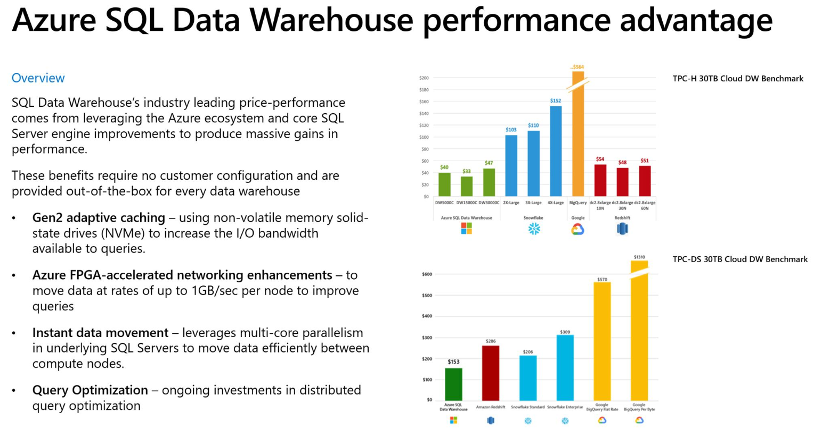

Slide 18
Questions?

